Slide 1
A comparative study between Niryo Collaborative robots:
Ned vs Ned 2
Akshay V - PES1UG20ME159
Amodh - PES1UG20ME160
M Mazen - PES1UG20ME204

Slide 2
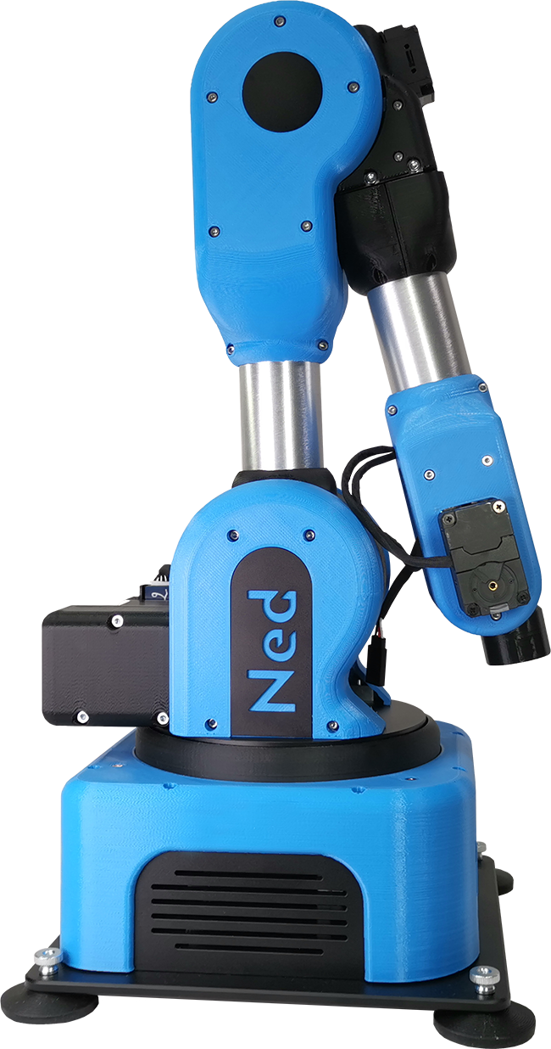
Niryo Ned
Ned is a six-axis collaborative robot, based on open-source technologies. It is intended for education and research. It is based on Ubuntu 18.04 and ROS Melodic.

Slide 3
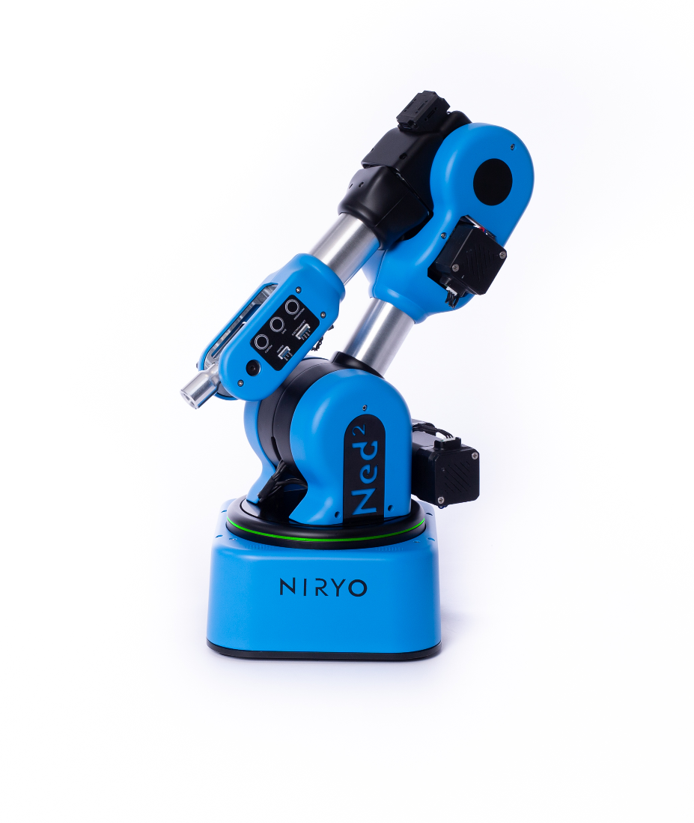
Niryo Ned 2
Ned2 is a six-axis collaborative robot, based on open-source technologies. It is intended for education, research and Industry 4.0. It is based on Ubuntu 18.04 and ROS Melodic.

Slide 4
Technical Comparison

Slide 5
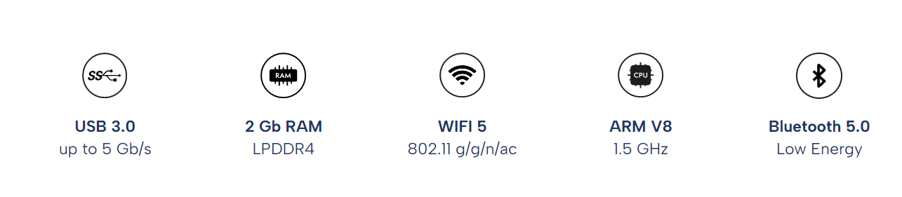
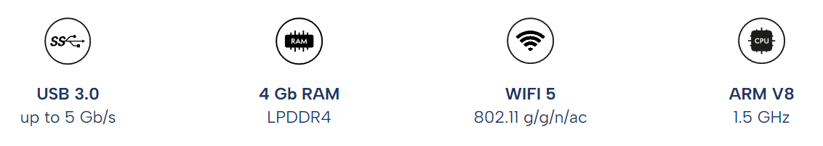
Comparison - Features
Ned 1
Raspberry Pi 4, with a 64-bit ARM V8 high performance processor, 2GB of RAM
Bluetooth 5.0
Ned2
Raspberry Pi 4, with a 64-bit ARM V8 high performance processor, 4GB of RAM
No bluetooth

Slide 6
Comparison - Technical Specifications
Parameters | Ned2 | Ned
Weight (kg) | 7 | 6,5 kg
Payload (g) | 300 | 300 g
Reach (mm) | 440 | 440 mm
Degree of freedom | 6 rotating joints | 6 rotating joints
Joints range (rad) | -2,949 ≤ Joint 1 ≤ 2,949 -2,09 ≤ Joint 2 ≤ 0,61 -1.34 ≤ Joint 3 ≤ 1,57 -2,089 ≤ Joint 4 ≤ 2,089 -1,919 ≤ Joint 5 ≤ 1.922 -2,53 ≤ Joint 6 ≤ -2,53 | -2,97 rad ≤ Joint 1 ≤ 2,97 rad -2,09 rad ≤ Joint 2 ≤ 0,61 rad -1.34 rad ≤ Joint 3 ≤ 1,57 rad -2,09 rad ≤ Joint 4 ≤ 2,09 rad -1,75 rad ≤ Joint 5 ≤ 0,96 rad -2,53 rad ≤ Joint 6 ≤ -2,53 rad

Slide 7
Comparison - Technical Specifications
Parameters | Ned2 | Ned
Joints speed limit (rad/s) | Joint 1 ≤ 0.785 Joint 2 ≤ 0.5235 Joint 3 ≤ 0.785 Joint 4 ≤ 1.57 Joint 5 ≤ 1.57 Joint 6 ≤ 1.775 | Joint 1 ≤ 2.6 rad/s Joint 2 ≤ 2.0 rad/s Joint 3 ≤ 2.5 rad/s Joint 4 ≤ 3.14 rad/s Joint 5 ≤ 3.14 rad/s Joint 6 ≤ 3.14 rad/s
TCP max speed (mm/s) | 468 | 1144 mm/s
Repeatability (mm) | +/- 0,5 | 0.5 mm
Footprint (mm) | 200x200 | 200x200 mm
Mounting | Table | Table

Slide 8
Comparison - Technical Specifications
Parameters | Ned2 | Ned
Temperature (°C) | 5 - 45 C | 5 - 45 C
Human-Machine interface | 3 control buttons (‘‘FreeMotion’’ button, button to save a pose and ‘‘Custom’’ button) LED, Ring-Speakers Microphone | No Human-Machine interface
I/O power supply | 5V | 5V for digital GPIO 12V for Switches output
Communication | Modbus TCP (master) TCP/IP | Modbus TCP (master) TCP/IP CAN (slave, compatible with NiryoStepper motors)

Slide 9
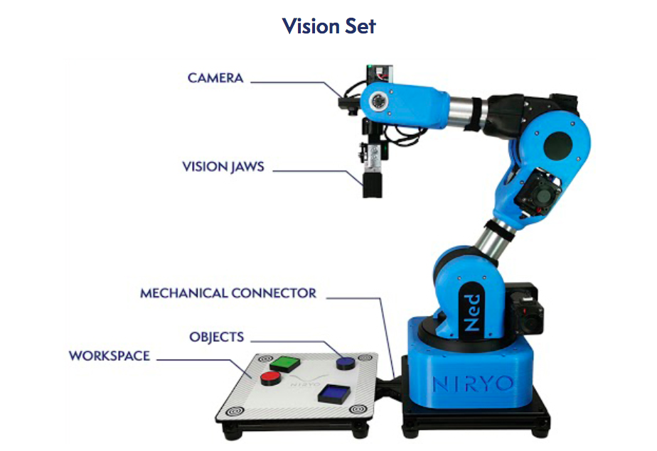
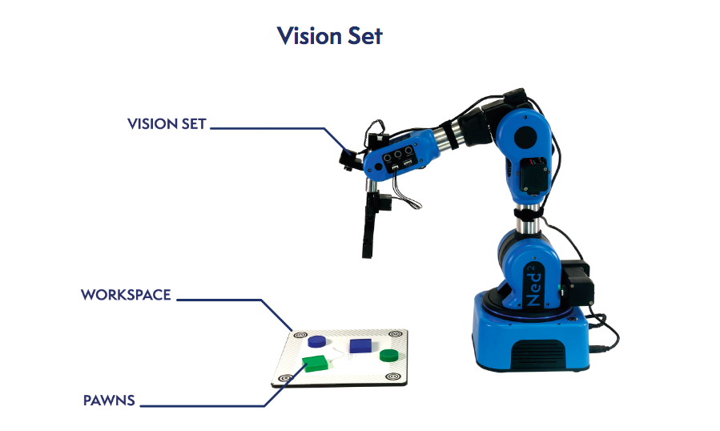
Comparison - Vision Set

Slide 10
Tools Technical Comparison

Slide 11
Comparison - Tools Specification
Ned2 and Ned is compatible with 5 different sorts of tools:
3 x Grippers
1 x Electromagnet
1 x Vacuum Pump
Custom grippers can also be made apart from the grippers provided with the robot, Ned 1 also comes with 3 custom grippers.
Gripper Description:
Large Gripper which has the ability to grab larger objects
The Adaptive Gripper which allow Ned2 to grab non-standard objects with complex shapes
The Vacuum Pump to grab objects with plane and non-porous surfaces;
The Electromagnet manipulate metallic objects

Slide 12
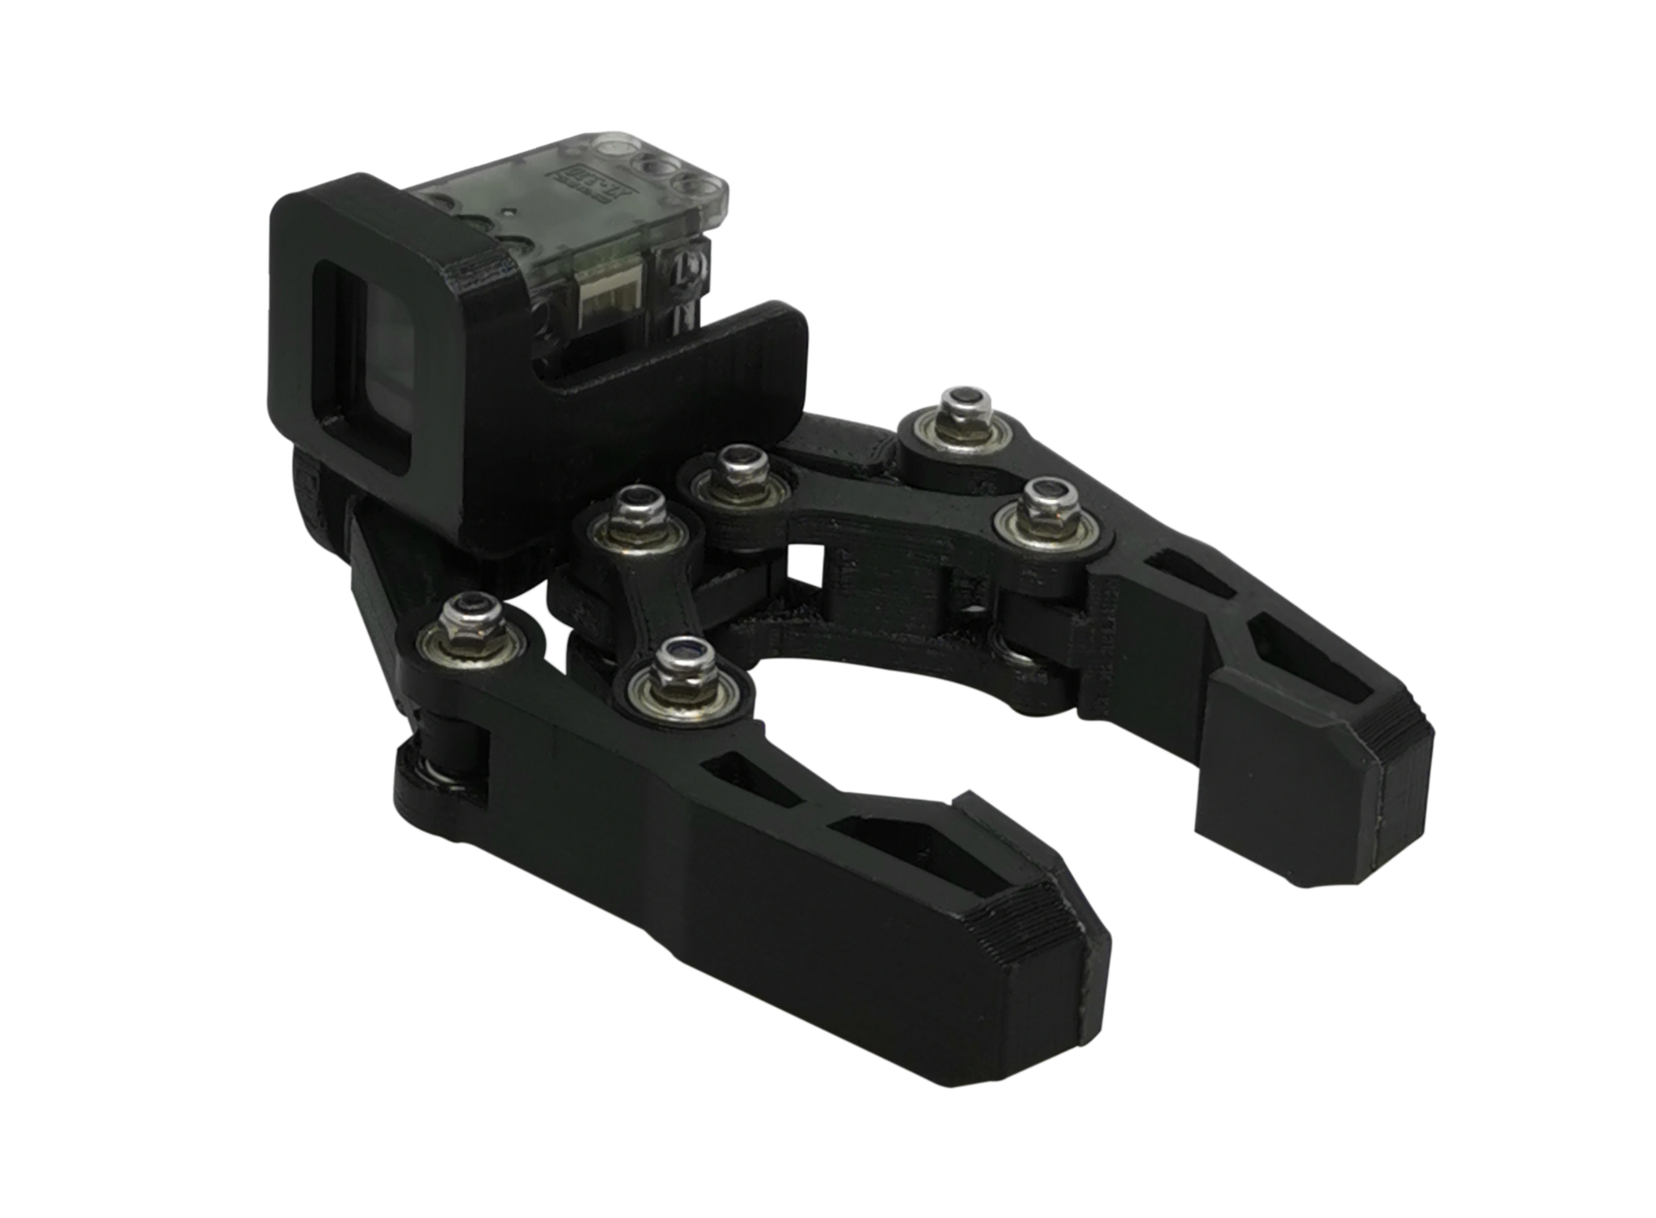
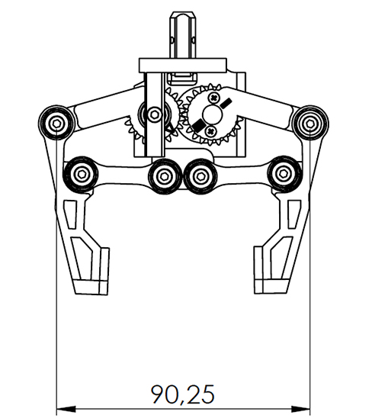
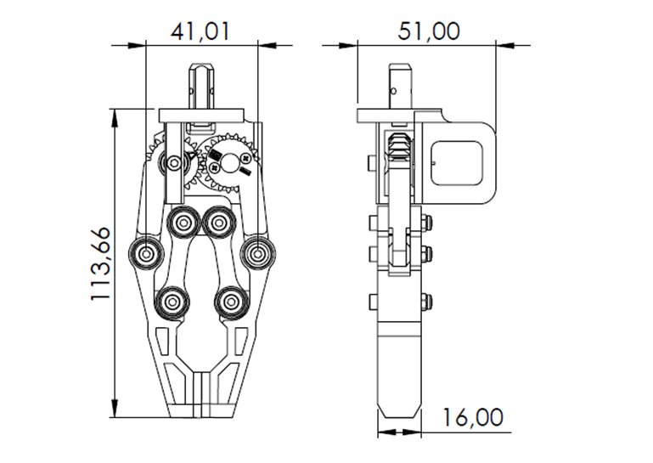
Comparison - Large Gripper
Ned1
Parameter | Description
Max operating width | 60 mm
Picking distance from end effector base | 80 mm
Motor | XL320 Servo Motor
Weight | 90 g
Power Supply | 7.6 V
Operating temperature | 5-45°C

Slide 13
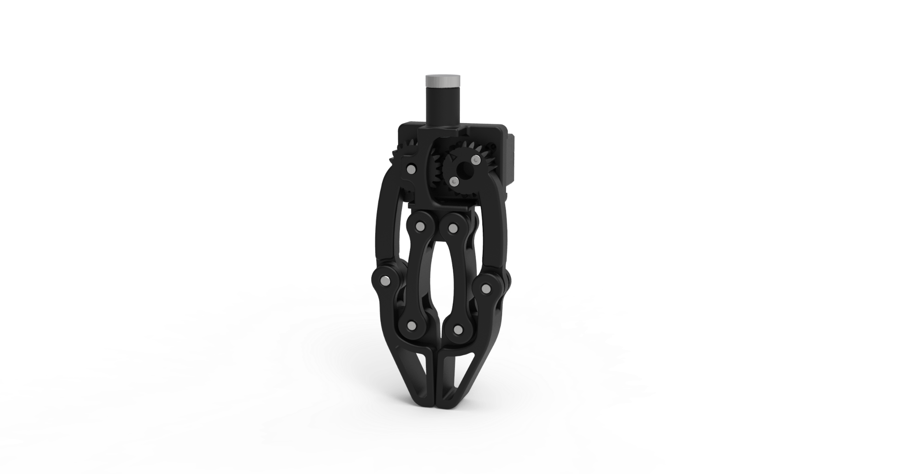
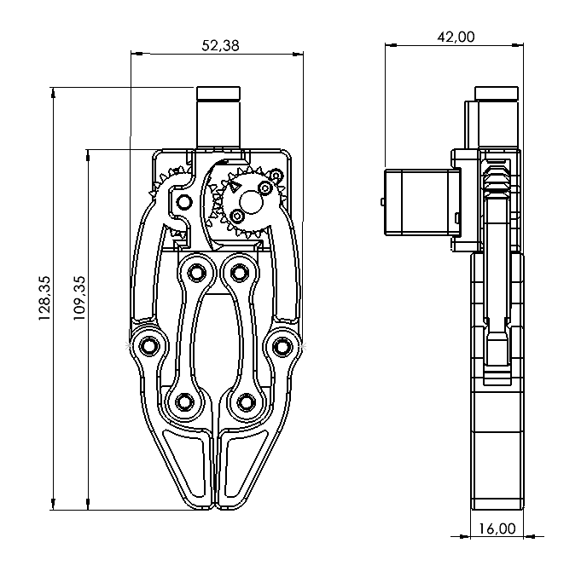
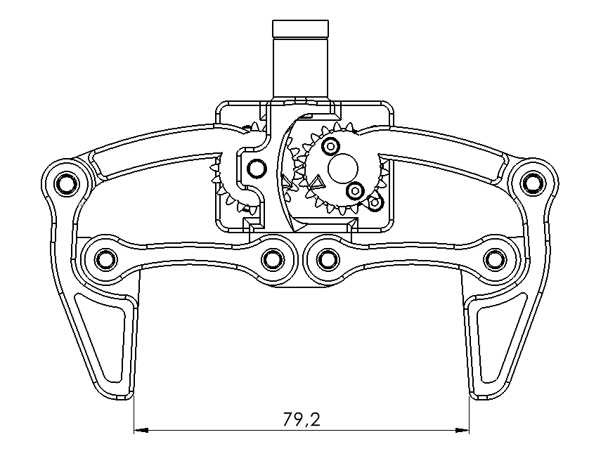
Comparison - Large Gripper
Ned2
Parameter | Description
Max operating width | 79.2 mm
Picking distance from end effector base | 109.35 mm
Motor | XL330 Servo Motor
Weight | 72.5 g
Power Supply | 5 V
Operating temperature | 5-45°C

Slide 14
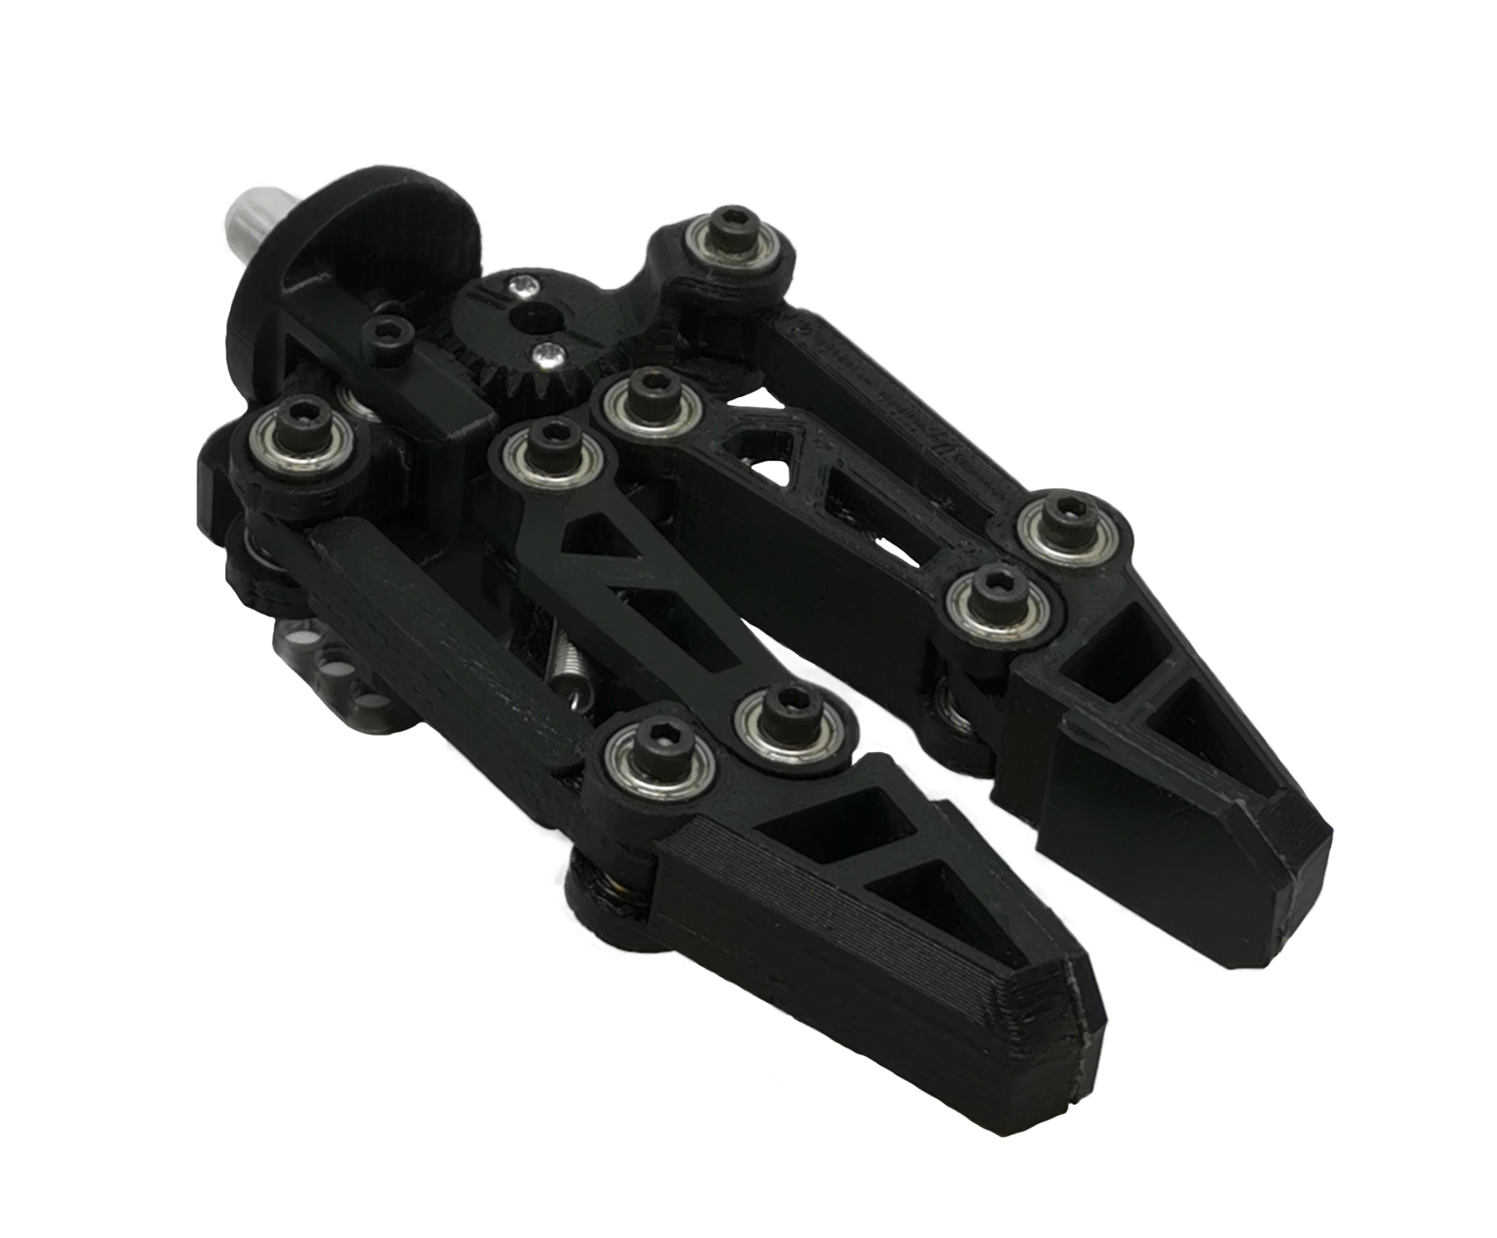
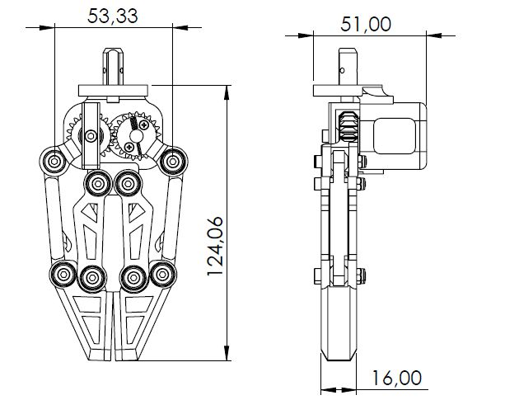
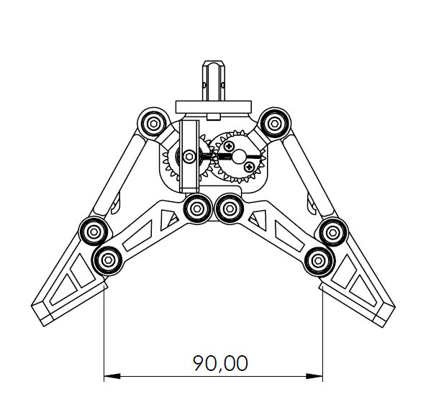
Comparison - Adaptive Gripper
Ned1
Parameter | Description
Max operating width | 90 mm
Picking distance from end effector base | 85 mm
Motor | XL320 Servo Motor
Weight | 110 g
Power Supply | 7.6 V
Operating temperature | 5-45°C

Slide 15
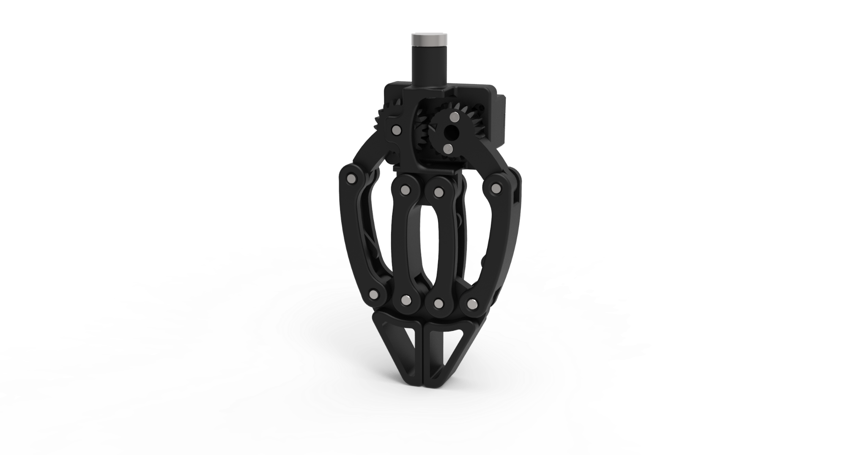
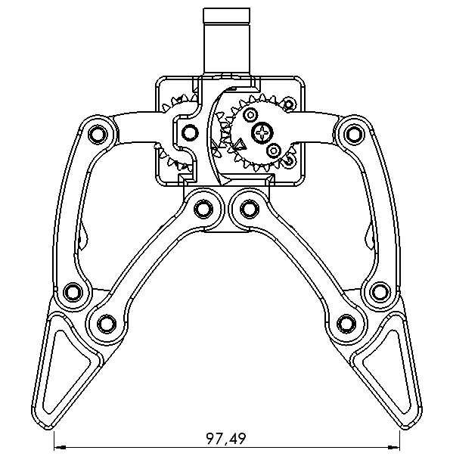
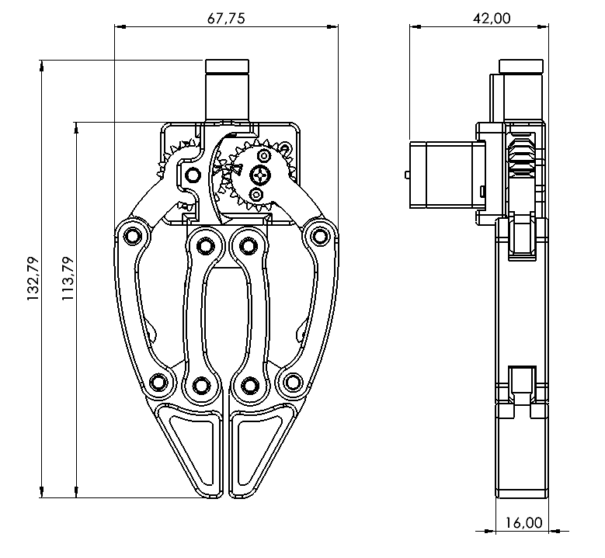
Comparison - Adaptive Gripper
Ned2
Parameter | Description
Max operating width | 97.49 mm
Picking distance from end effector base | 113.79 mm
Motor | XL330 Servo Motor
Weight | 83 g
Power Supply | 5 V
Operating temperature | 5-45°C

Slide 16
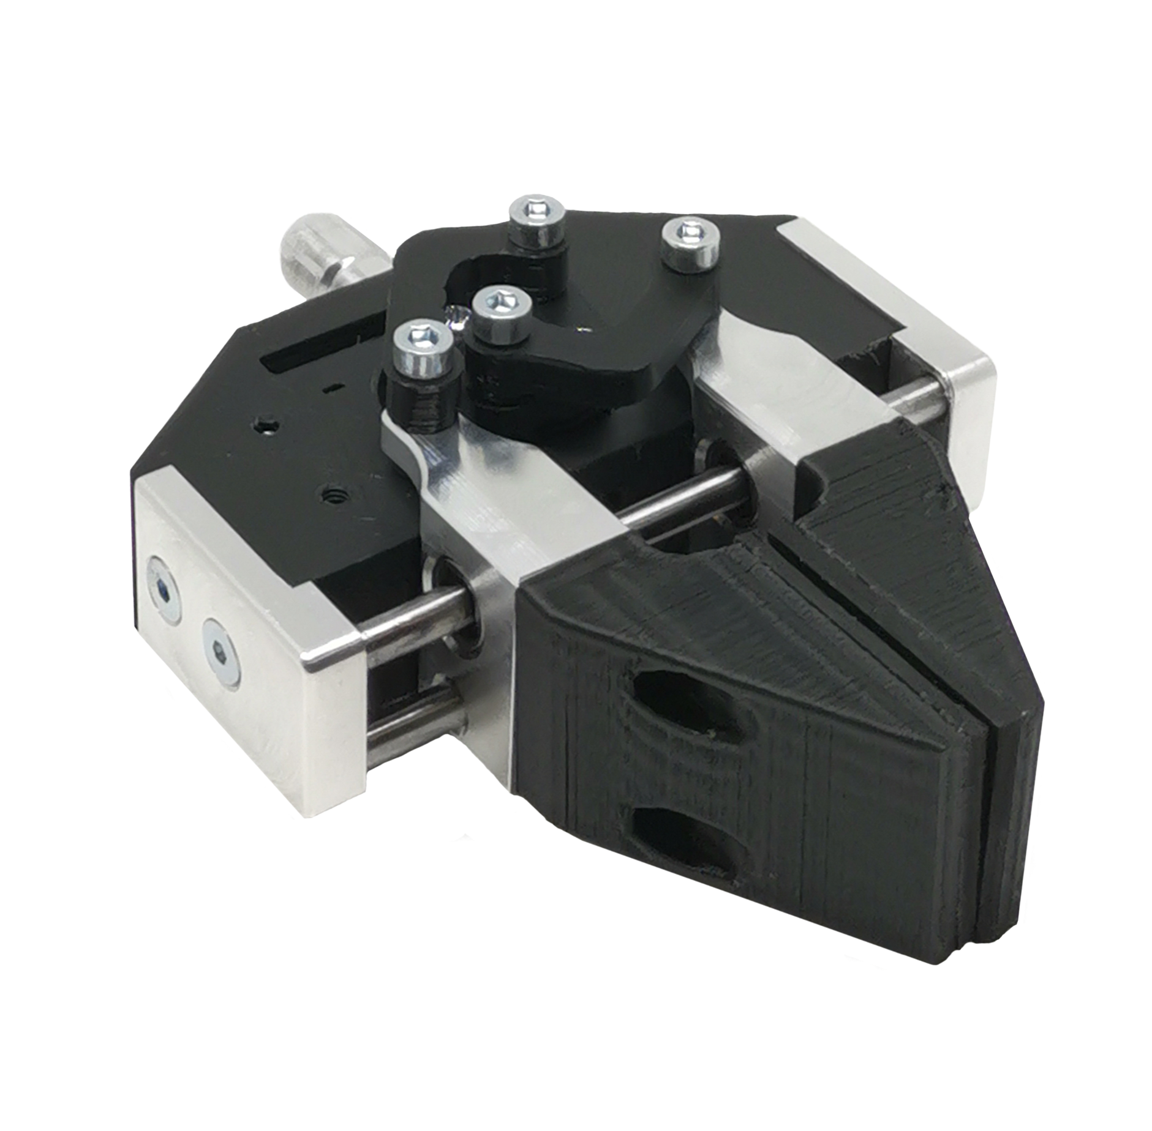
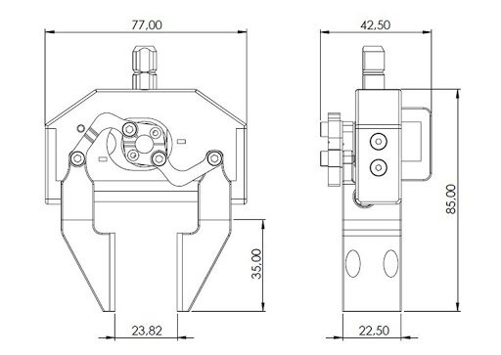
Comparison - Standard Gripper
Ned1
Parameter | Description
Max operating width | Standard Jaws: 23.82 mm
Picking distance from end effector base | Standard Jaws: 85 mm
Motor | XL320 Servo Motor
Weight | Standard Jaws: 109 g
Power Supply | 7.6 V
Operating temperature | 5-45°C

Slide 17
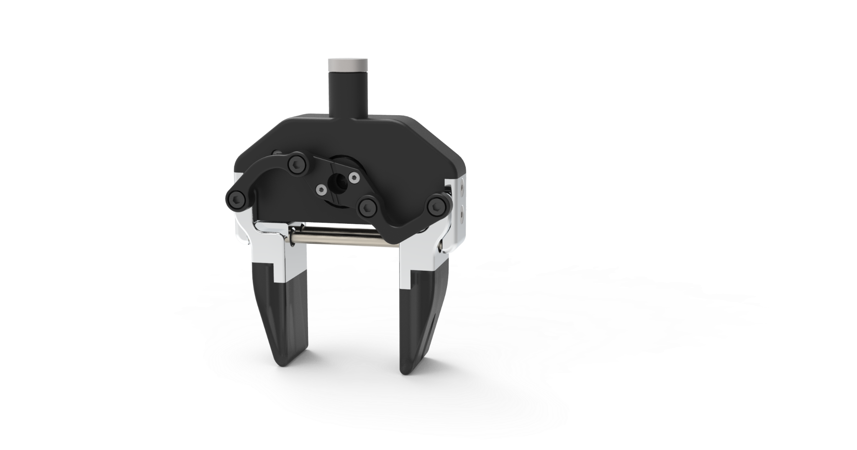
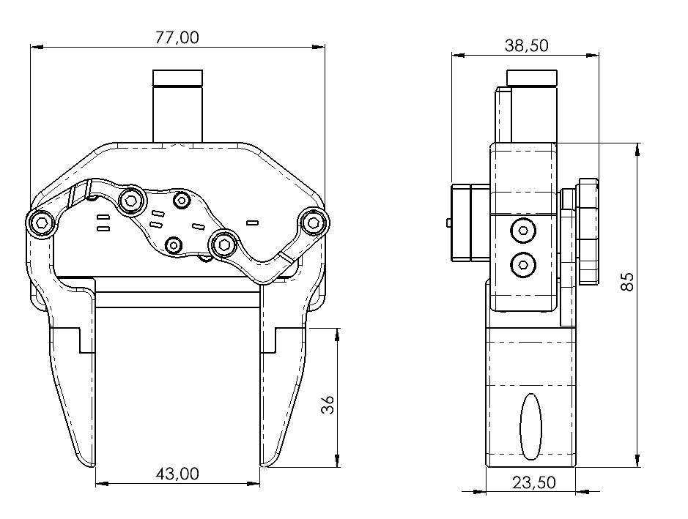
Comparison - Standard Gripper
Ned2
Parameter | Description
Max operating width | 43 mm
Picking distance from end effector base | 85 mm
Motor | XL330 Servo Motor
Weight | 87 g
Power Supply | 5 V
Operating temperature | 5-45°C

Slide 18
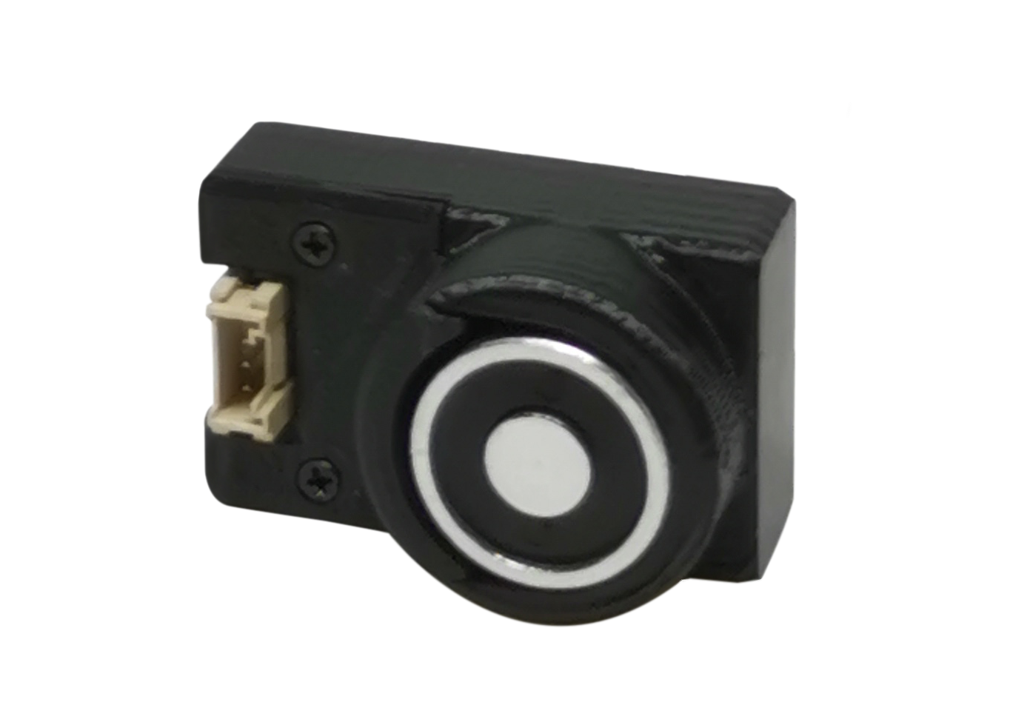
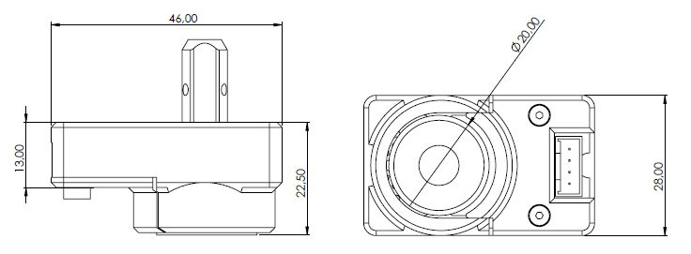
Comparison - Electromagnet
Ned1
Parameter | Description
Max operating width | 20 mm
Picking surface | 20 mm
Picking distance from end effector base | 22.5 mm
Control interface | Digital output
Weight | 42 g
Power Supply | 5 V
Operating temperature | 5-45°C

Slide 19
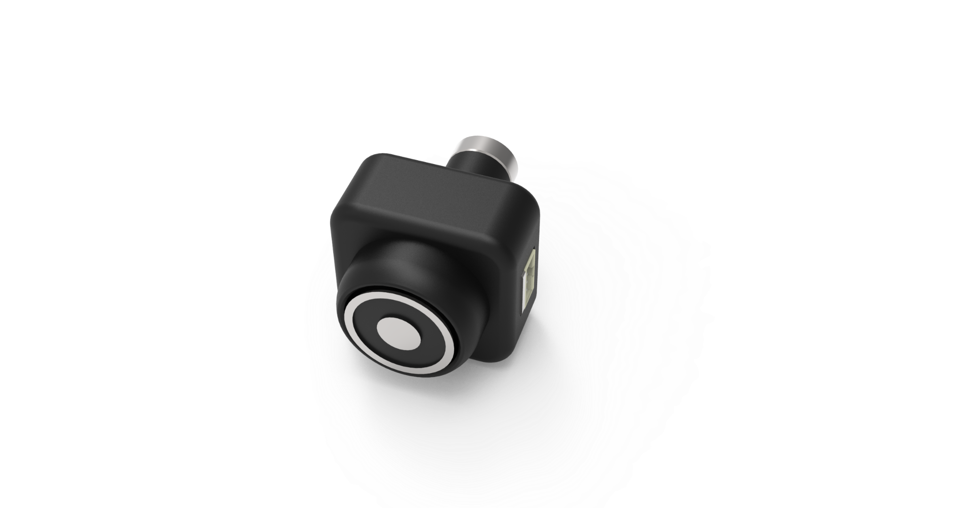
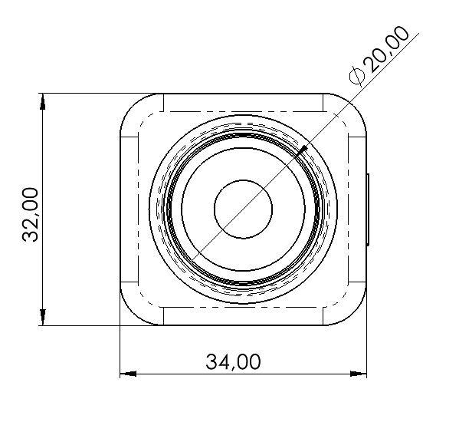
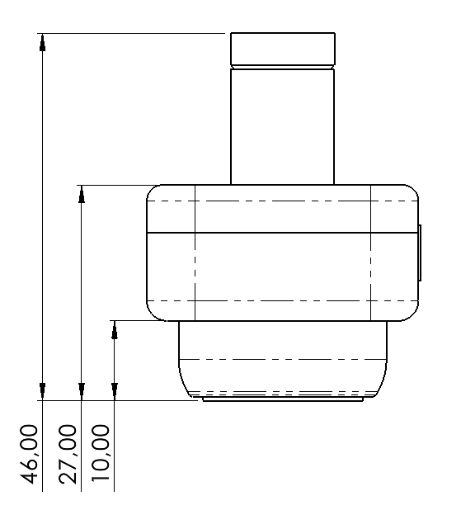
Comparison - Electromagnet
Ned2
Parameter | Description
Max operating width | 20 mm
Picking surface | 20 mm
Picking distance from end effector base | 27 mm
Control interface | Digital output
Weight | 44.5 g
Power Supply | 5 V
Operating temperature | 5-45°C

Slide 20
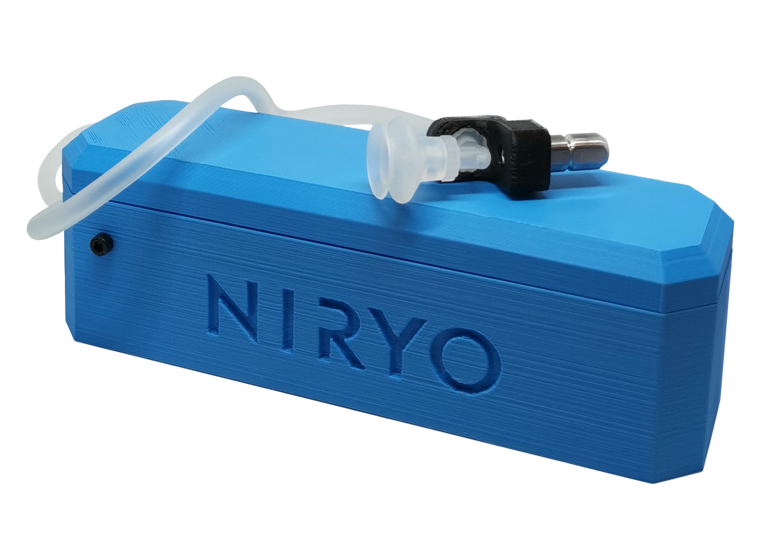
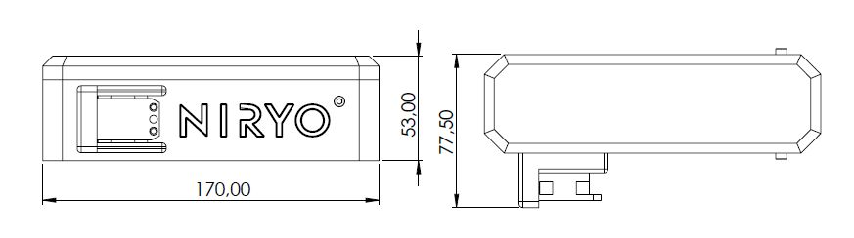
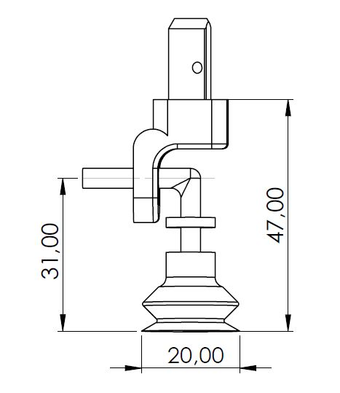
Comparison - Vacuum Pump
Ned1
Parameter | Description
Vacuum Pump control | Integrated XL320 servo motor
Weight | 10 g
Total weight | 170 g
Payload | 300 g
Power Supply | 7.6 V
Operating temperature | 5-45°C
Vacuum Tube dimension | 20 mm
Picking distance from end effector base | 47 mm

Slide 21
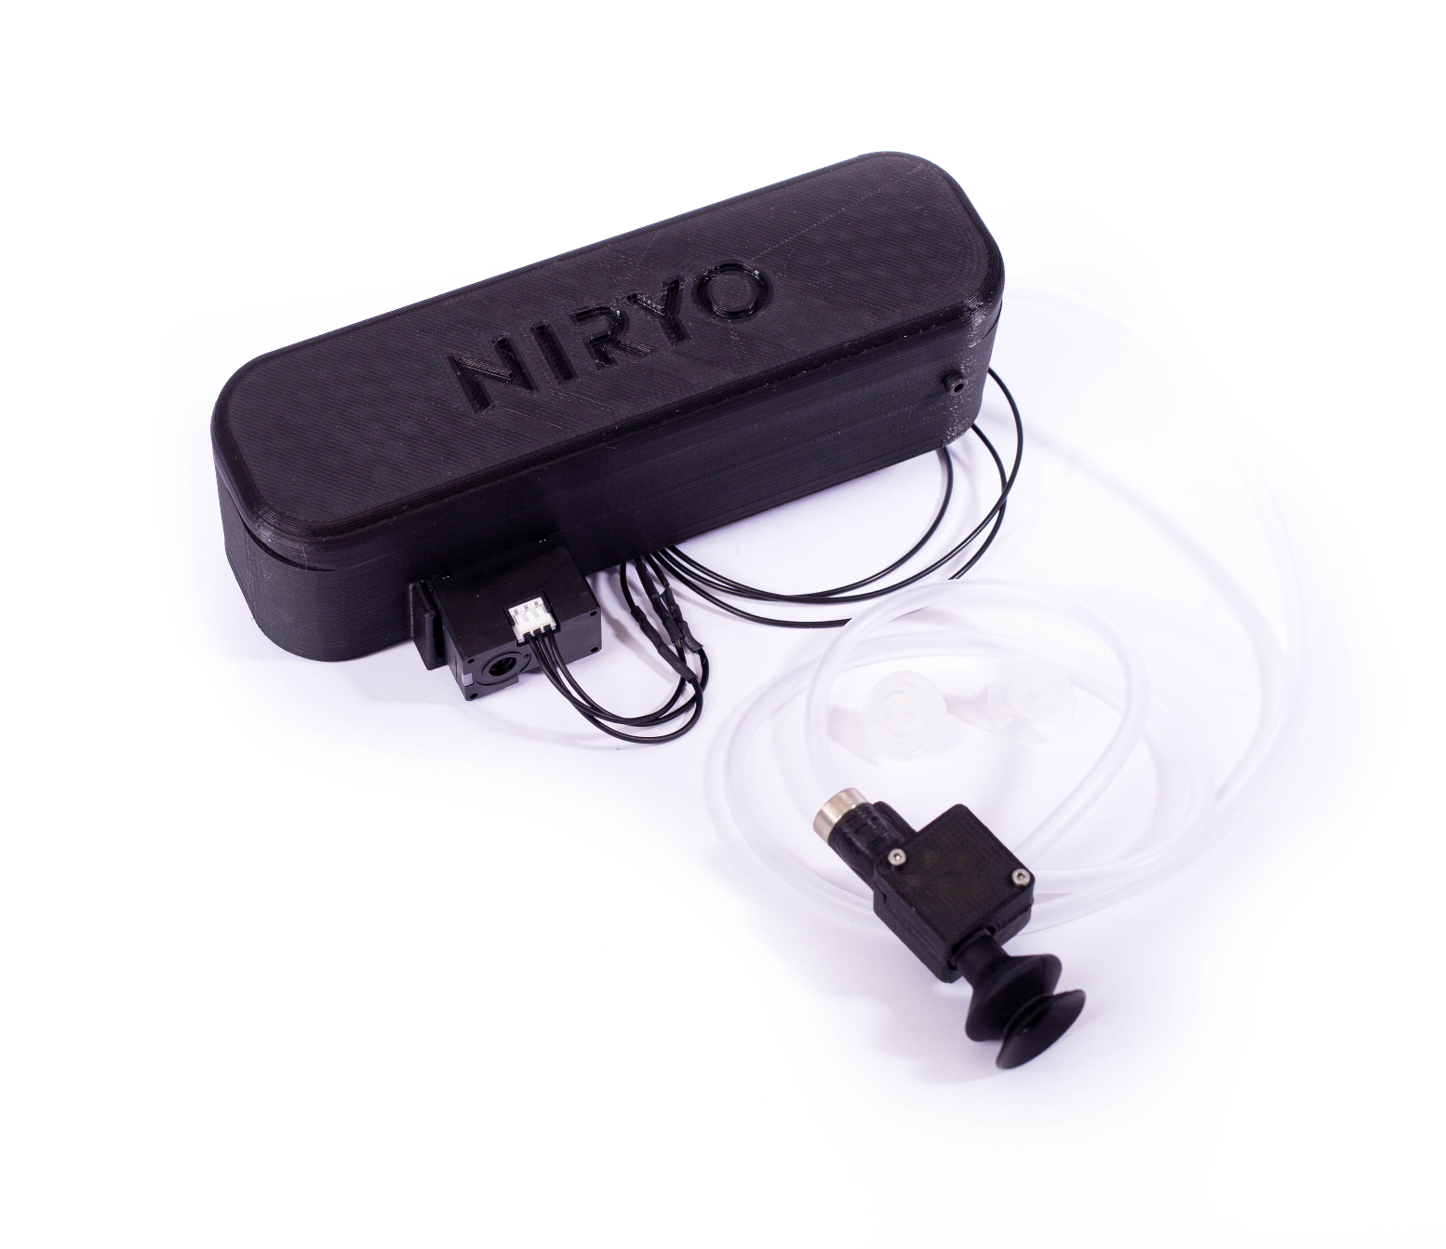
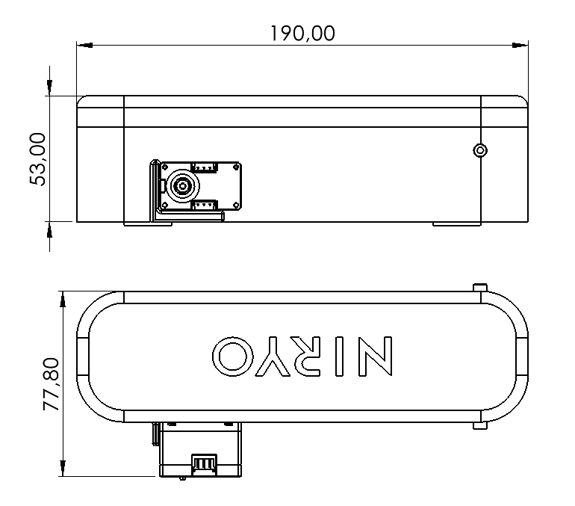
Comparison - Vacuum Pump
Ned2
Parameter | Description
Vacuum Pump control | Integrated XL330 servo motor
Weight | 18 g
Total weight | 183 g
Payload | 300 g
Power Supply | 5 V
Operating temperature | 5-45°C
Vacuum Tube dimension | 20 mm
Picking distance from end effector base | 47.5 mm

Slide 22
Design Comparison

Slide 23
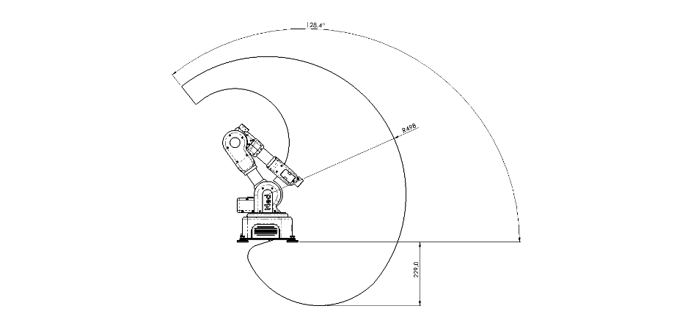
Comparison - Workspaces
Ned & Ned 2

Slide 24
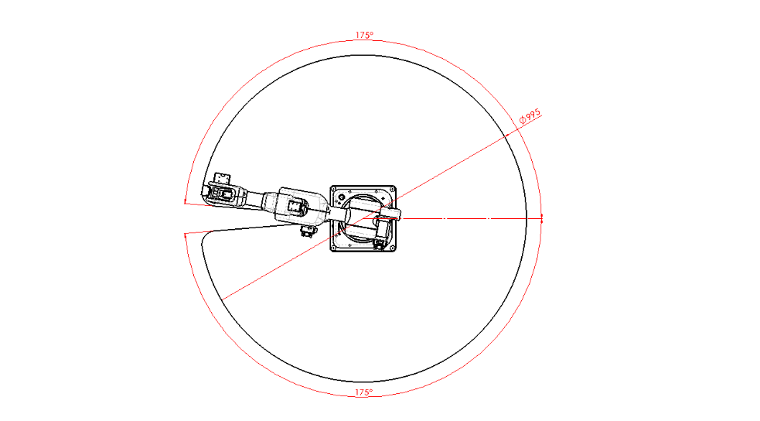
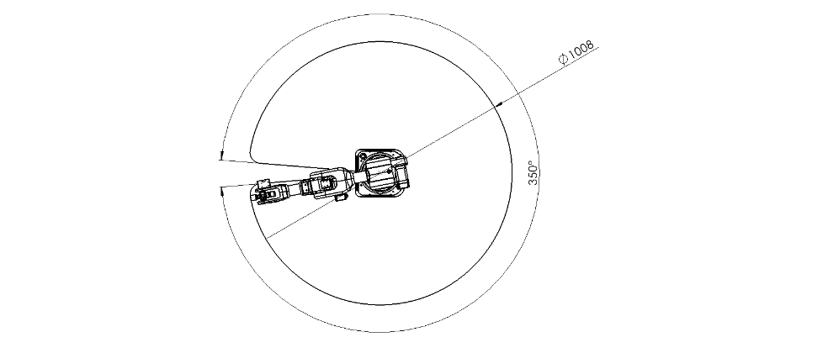
Comparison - Workspaces
Ned 1
Ned 2

Slide 25
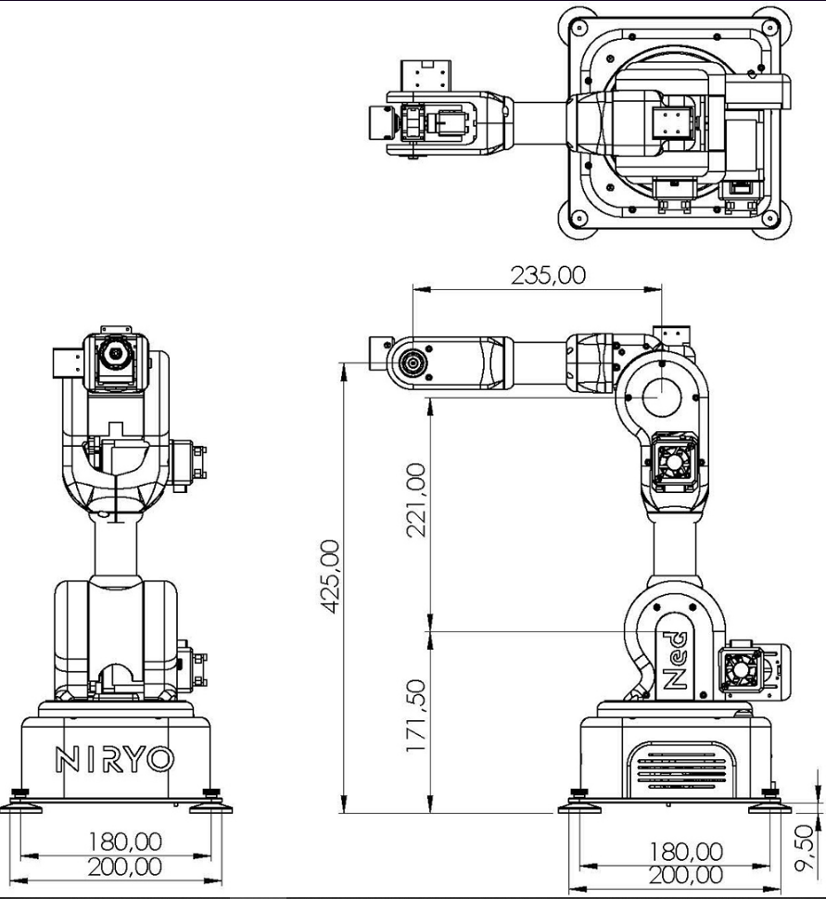
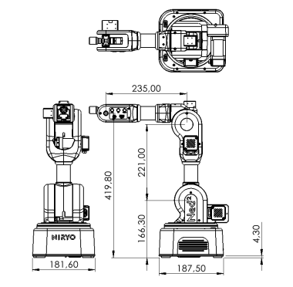
Comparison - Design
Ned 1
Ned 2

Slide 26
Electrical Comparison

Slide 27
Comparison - Electrical
Ned 1
The power supply of the motors (11.1V, 8V);
Ned’s grippers are powered by 8V. A risk of short circuit and sparks exists. Be sure to make the installations with the power disconnected.
Ned 2
The power supply of the motors (12V , 11.4V, 5V)
Ned2’s grippers are powered by 5V.

Slide 28
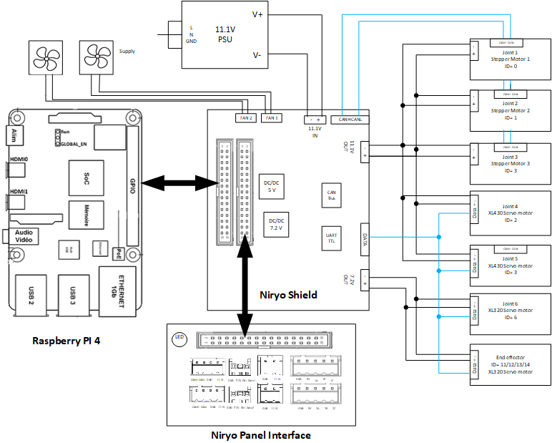
Comparison - Electrical Interface
Ned 1

Slide 29
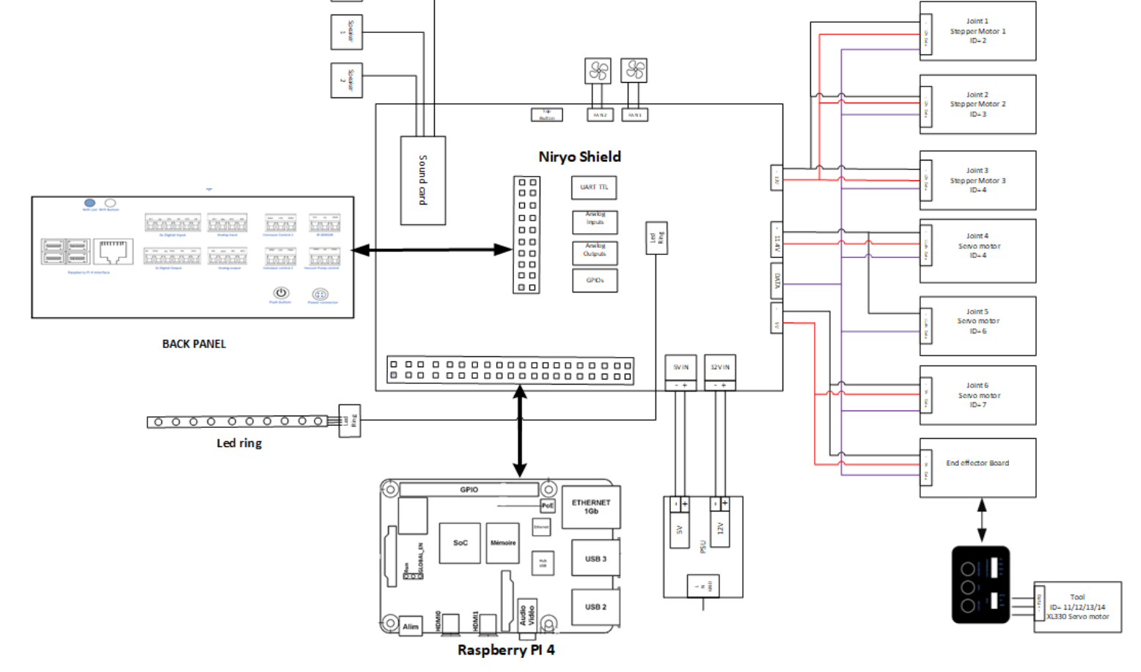
Comparison - Electrical Interface
Ned 2

Slide 30
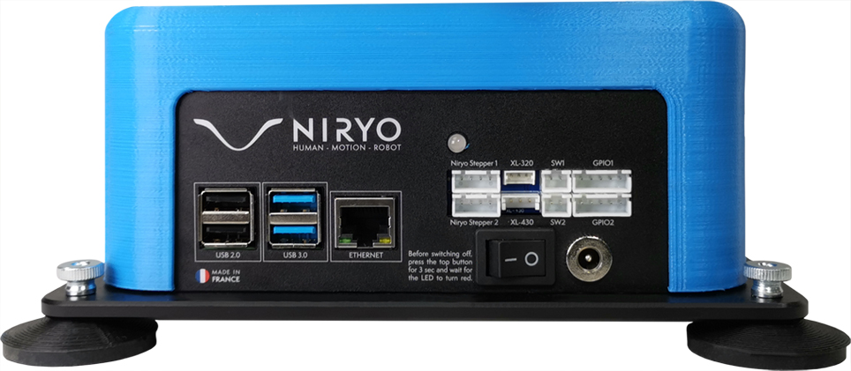
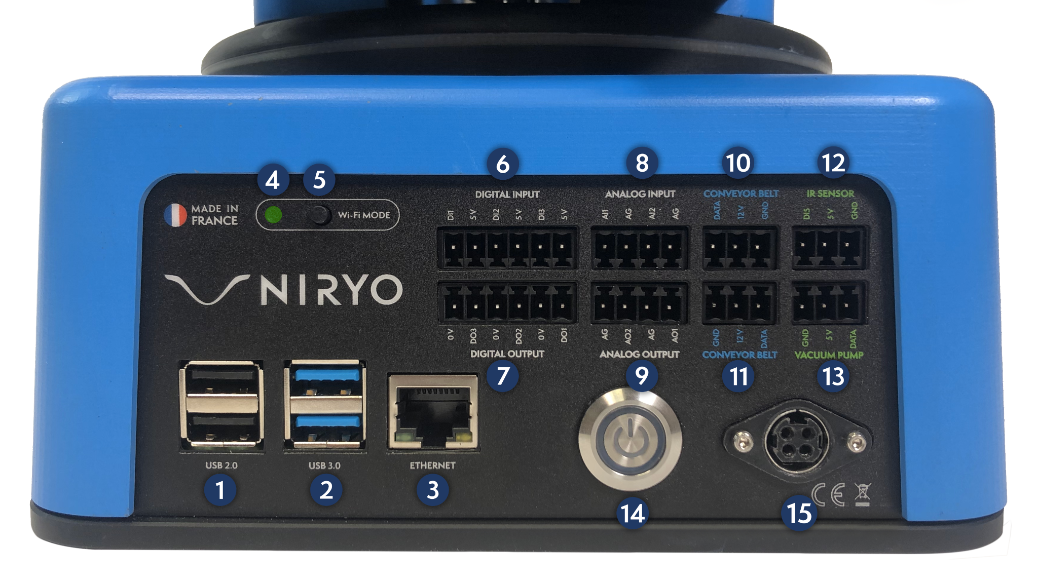
Comparison - Back-Panel Interface
Ned 1
Ned 2

Slide 31
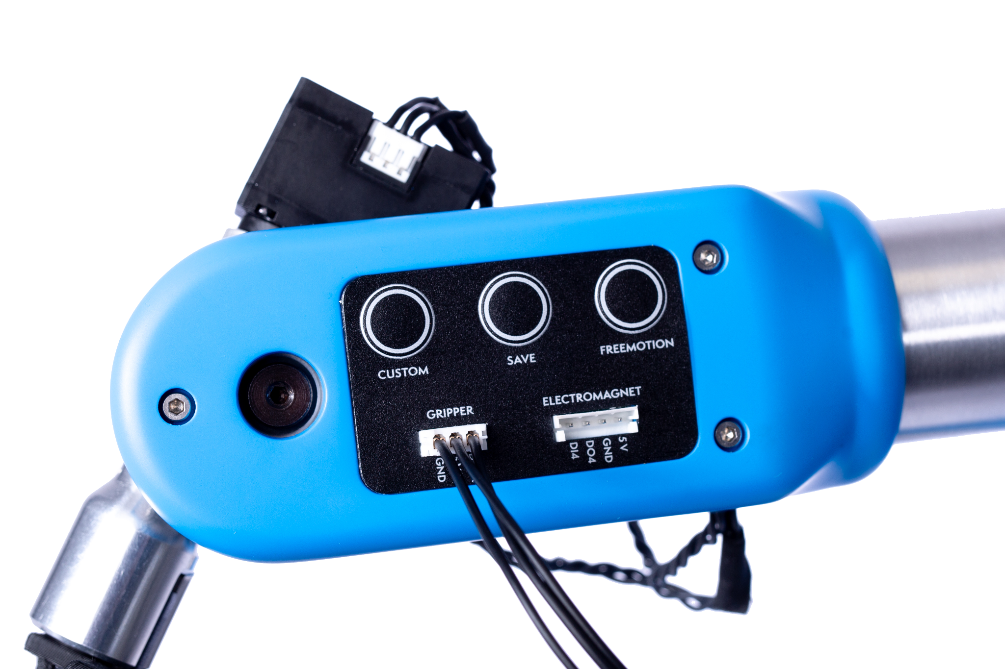
Comparison - Control Panel
Ned 2

Slide 32
Motors

Slide 33
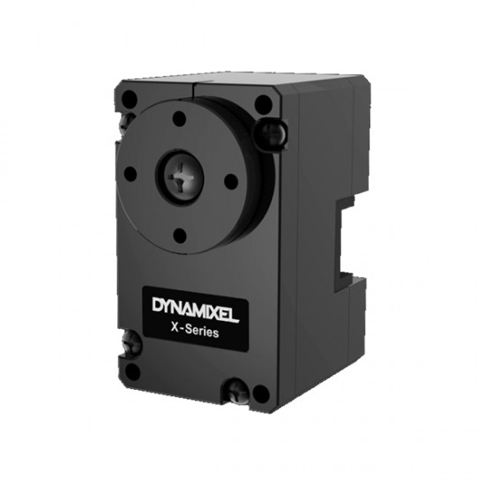
Motors Specification
Dynamixel XL330 Servo Motor
(Ned2)
Input voltage [V]: 3.7–6V (5V recommended)
Stall torque [N-m]: 0.52
Stall current [A]: 1.5
No-load speed [rpm]: 104 rpm

Slide 34
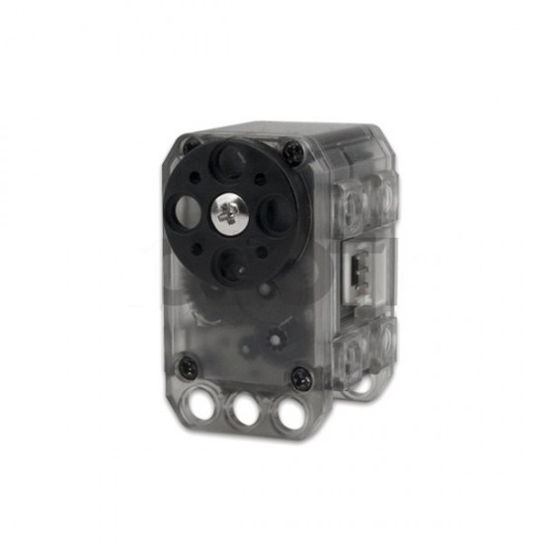
Motors Specification
Dynamixel XL320 Servo Motor (Ned1)
Input voltage [V]: 6–8.4V (7.4V recommended)
Stall Torque : 0.39 [N.m] (at 7.4 [V], 1.1 [A])
No-load speed [rpm]: 114 [rev/min] (at 7.4 [V])
Gear-Ratio : 238 : 1

Slide 35
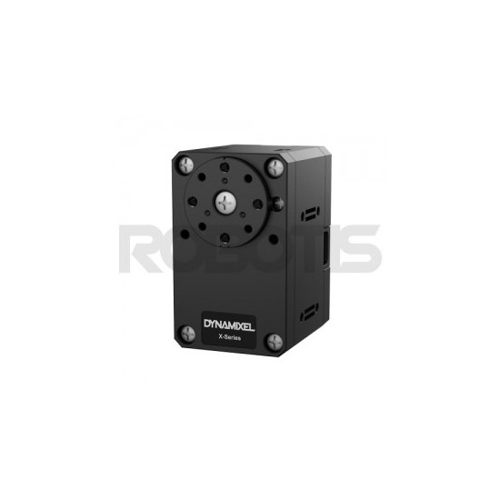
Motors Specification
Dynamixel XL430 Servo Motor
Gear Ratio: 353.5 : 1
Operation Voltage: 10~14.8V (Recommended voltage : 12V)
Stall Torque: 4.1 @ 12.0V, 2.3A / Standby current: 40 mA
No Load Speed: 46rpm @ 12.0V
TTL / Motor: Maxon Motor
Baud Rate: 9600 bps ~ 4.5 Mbps

